Slide 1
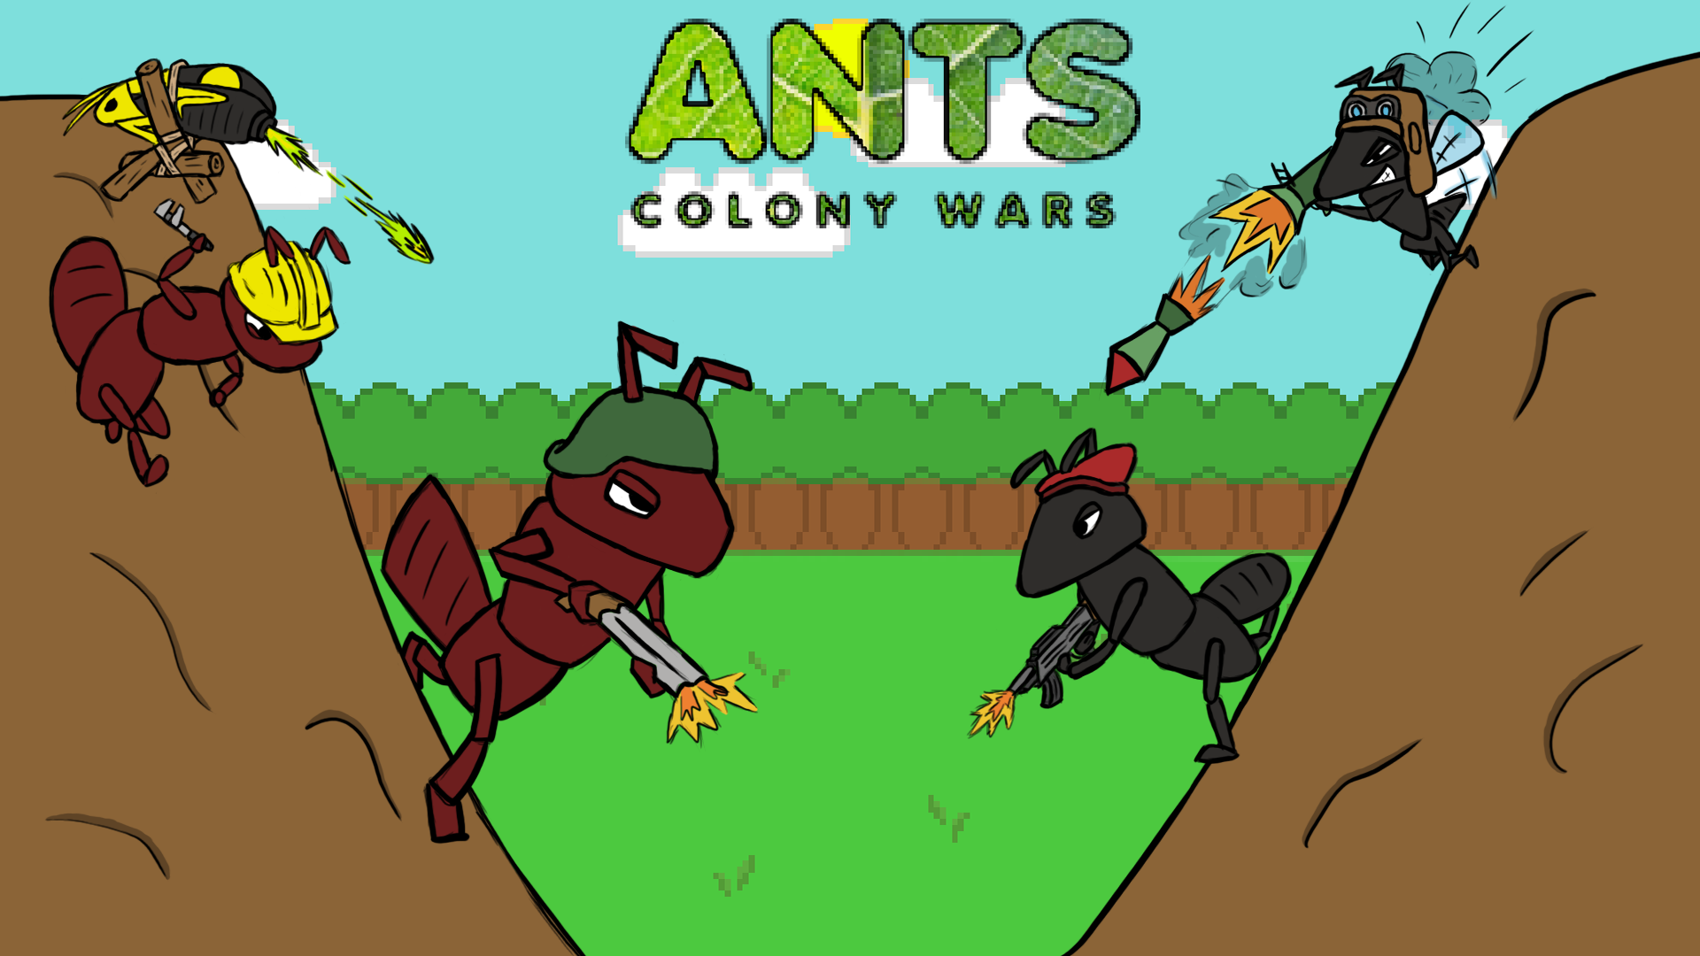

Slide 2
Game Synopsis (Stanley)
CAKE

Slide 3
Features in more detail (Stanley)

Slide 4
Gameplay from each level 1 (Stanley)

Slide 5
Gameplay from each level 2 (Stanley)

Slide 6
Concept art from paper to engine (Harry)

Slide 7
Sprites and characters (Harry)

Slide 8
Level design from concept to engine (Stanley)

Slide 9
Extra features added (Danny)

Slide 10
Bugs – Coding (Gary)

Slide 11
Bugs – Graphics (Gary)
Original picnic table – fixed by recreating in Maya or 3ds MAX
Sprite animations not playing properly
If the level isn’t even the ants can fall off
Character gets sent flying if it stands on a destructible bit of terrain

Slide 12
Conclusion (Danny)

Slide 13
What we learnt
Time management – graphic of a clock going around clockwise

Slide 14
Team dyanmics

Slide 15
What went well

Slide 16
What could’ve been better

Slide 17
How we feel

